Slide 1
Introduction to Machine Learning
By: Pooya Darvehei

Slide 2
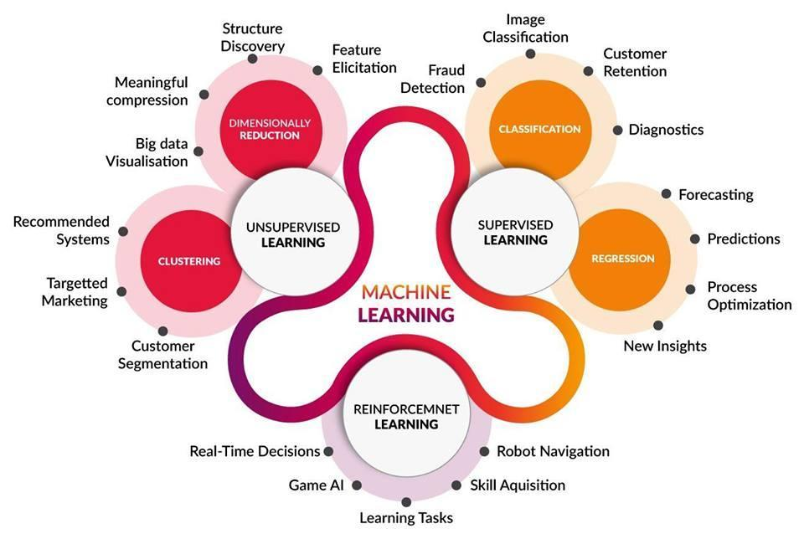

Slide 3
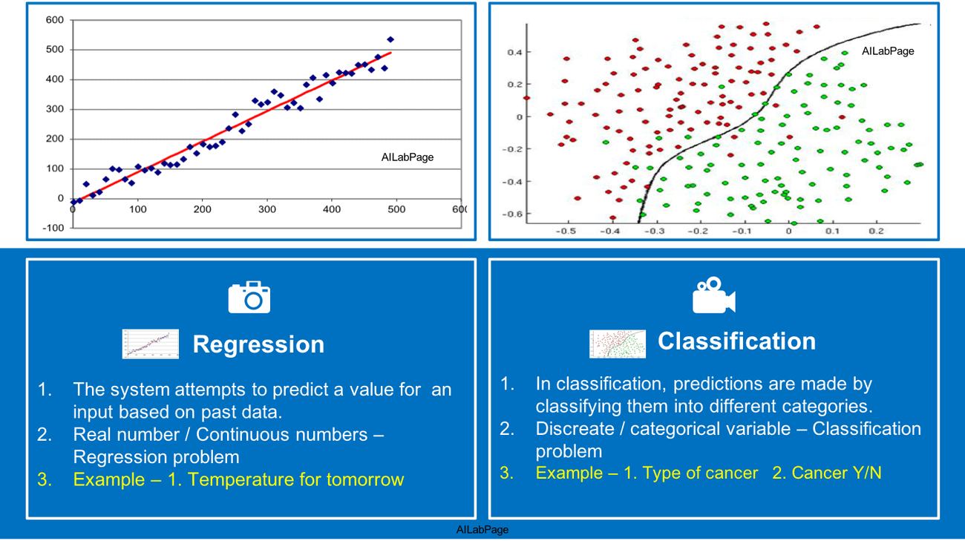
Supervised Learning

Slide 4
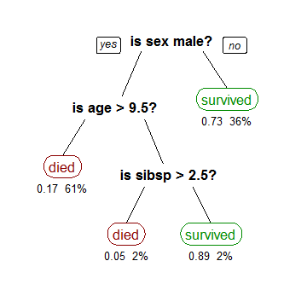
Decision Tree
At each node the tree splits the data into two so that the error is minimized.
We can define the depth of the tree
It can go as high as 100% accuracy on training set

Slide 5
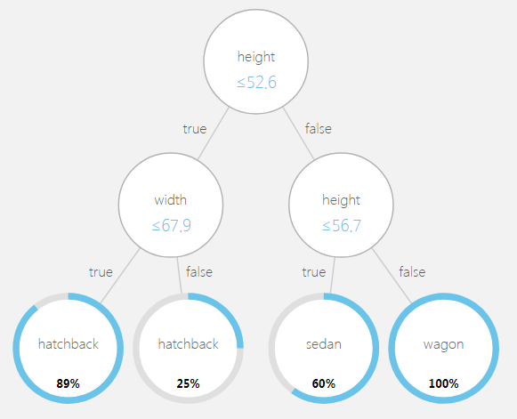
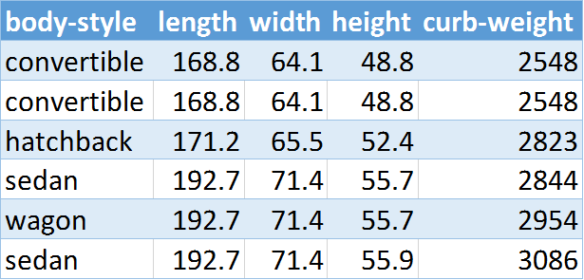
Decision Tree

Slide 6
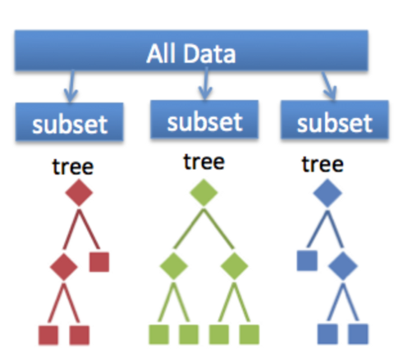
Bagging
Uses multiple trees
Selects a random subset of data for each tree
Better performance compared to a single tree
Less likely to overfit the data
When we select a subset for training we can test the model on the rest (OOB score)

Slide 7
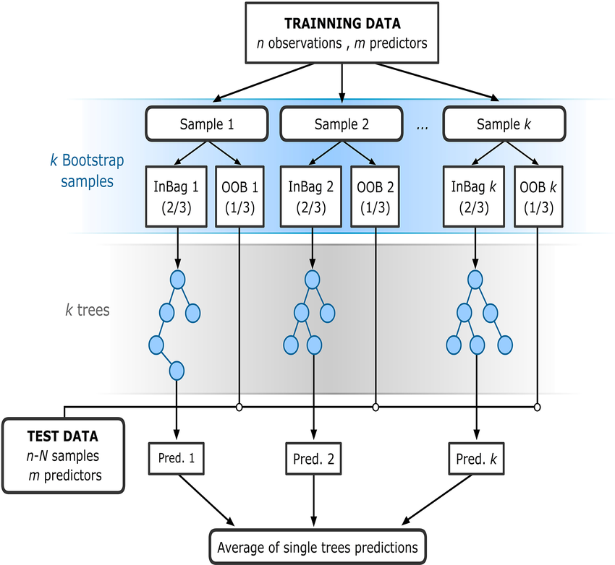
Random Forest
It’s an extension of bagging
For each tree it only uses a random subset of the features
Performs better than Bagging
It hardly ever overfits
Return OOB score as well

Slide 8
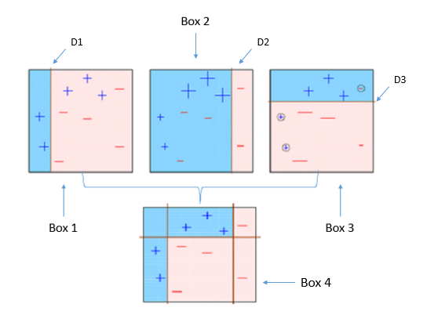
Adaboost
It’s a specific type of boosting
Models are added one by one and each have a weight
At each stage the weights are updated
The final prediction is a weighted average of all the models
Every tree on its own is a weak model

Slide 9
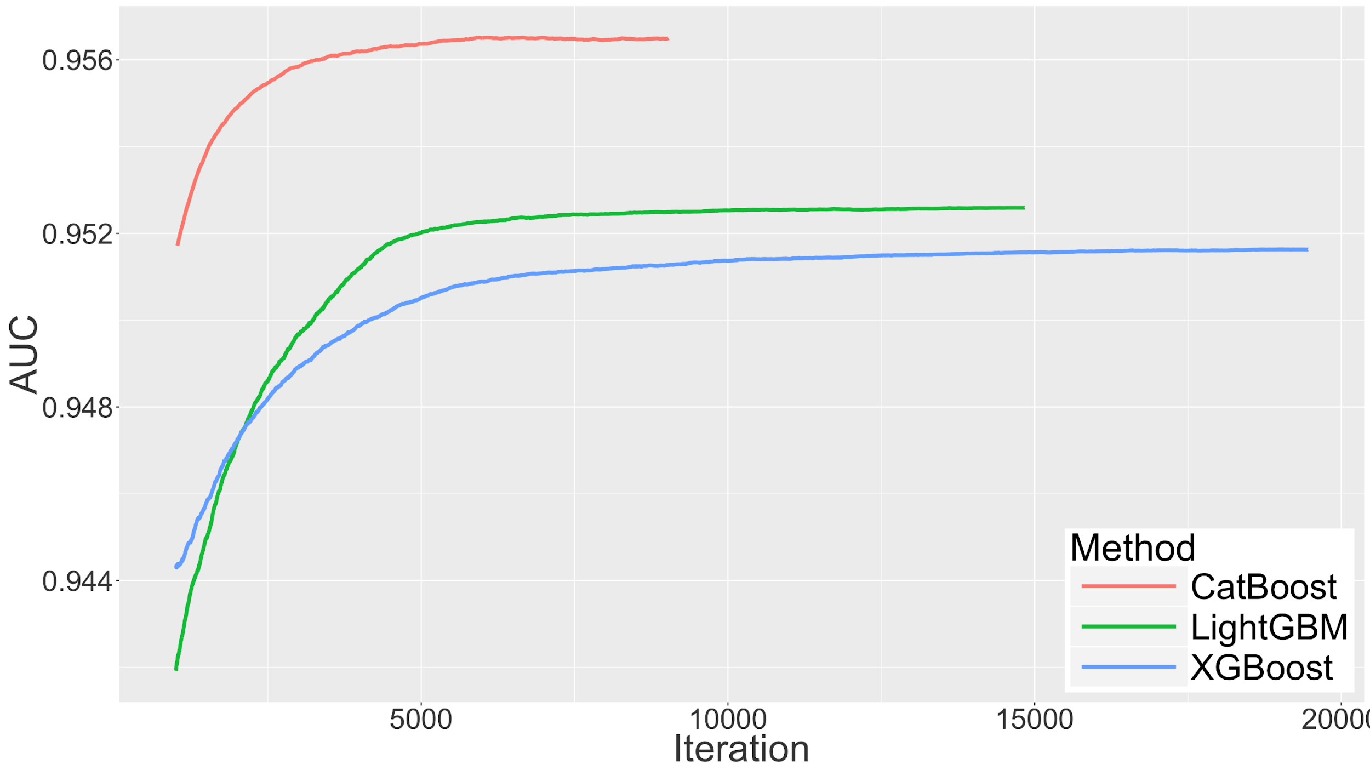
Gradient Boosted trees
It’s another type of boosting
Each new tree is added using the gradients to minimize the loss function.
There are a few libraries that use a variation of gradient boosting:
Xgboost
LightGBM
CatBoost

Slide 10
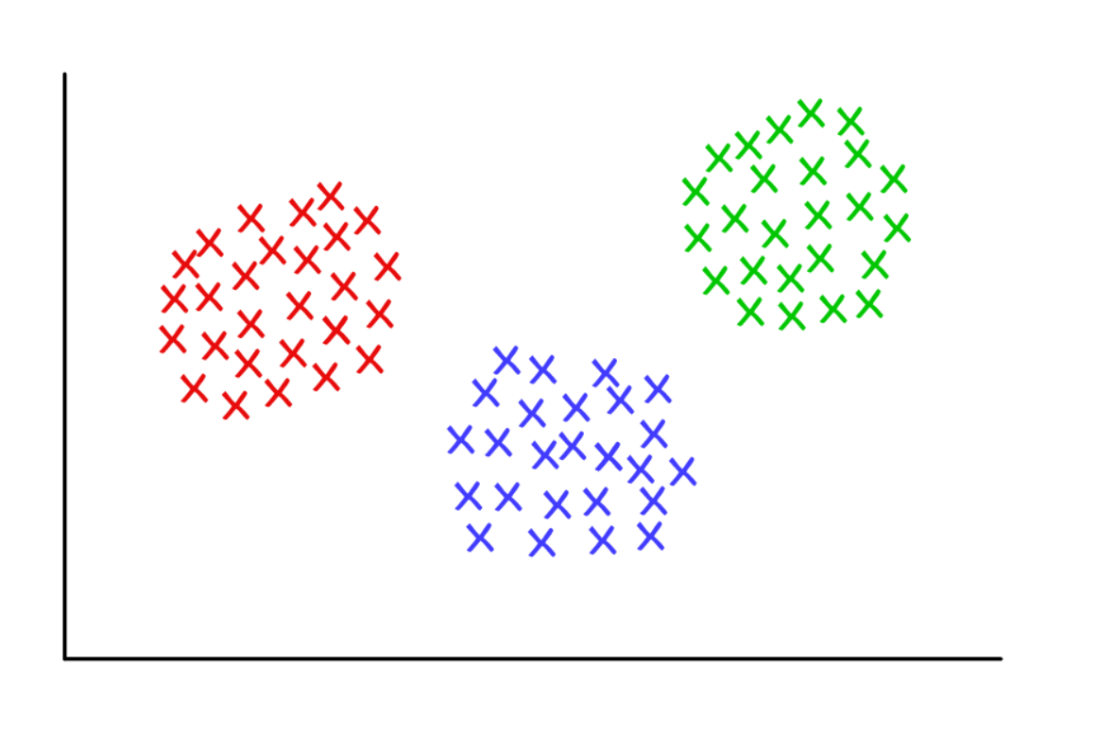
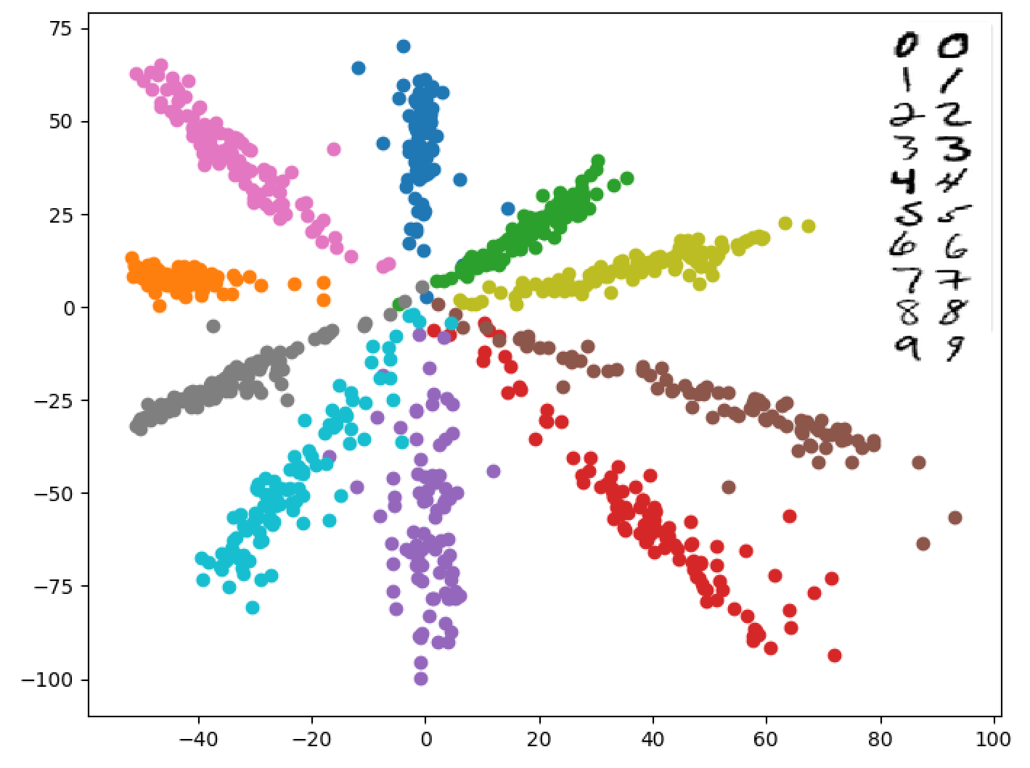
Unsupervised learning

Slide 11
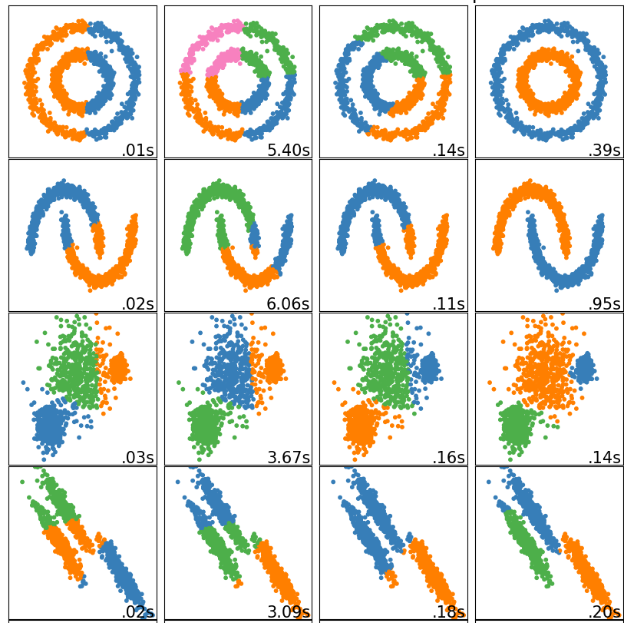
Clustering
We want to know
The number of clusters
Cluster each point belongs to
Cluster a new point would belong to
Methods:
K-Mean
DBSCAN
Hierarchical
Mean Shift

Slide 12
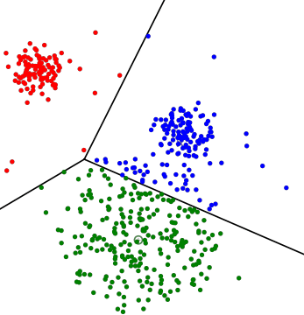
K-mean Clustering
Start with N random centroids.
Cluster points based on the centroid they are closest to.
Average all the points in a cluster and use that as the new centroid.
Repeat from step 2 until centroids stop moving.

Slide 14
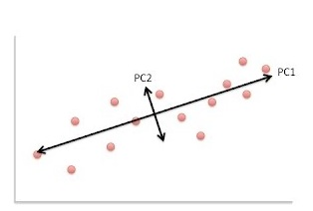
Dimensionality reduction
We want to lower the number of features in the data while preserving the information as much as possible.
Methods:
Principal Component Analysis (PCA)
Kernel PCA
Non-negative matrix factorization (NMF)
Linear Discriminant Analysis (LDA)
Autoencoders

Slide 15
Principal Component Analysis
Calculates the covariance matrix of the features.
Finds the eigenvectors of the covariance matrix to find new axes.
Converts the data from old axes to new axes.

